Slide 1
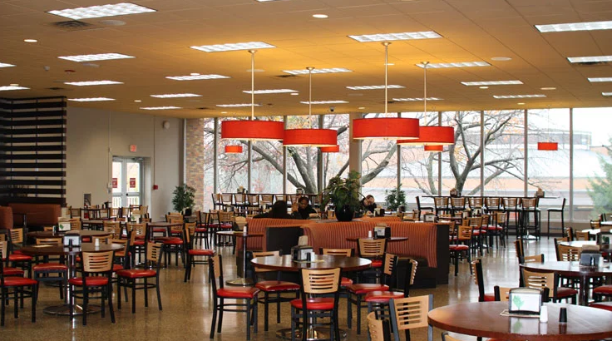
University Cafeteria Management System

Slide 2
Project Vision and Objectives
Digital transformation of traditional cafeteria operations
Enhanced student dining experience through technology
Operational efficiency improvements for staff
Data-driven decision support for management

Slide 3
Market Problem and Solution Fit
Current Challenges: Manual processes, long queues, limited payment options
Solution Benefits: Streamlined operations, reduced wait times, multiple payment methods
Value Proposition: Integrated platform addressing all cafeteria management needs

Slide 4
System Architecture Overview
High-level architectural diagram
Technology stack breakdown
Design pattern implementation highlights
Integration points with external systems

Slide 5
Key Features - Student Experience
Intuitive menu browsing and ordering interface
Shopping cart with real-time updates
Loyalty points accumulation and redemption
Order history and status tracking

Slide 6
Key Features - Staff Operations
Order management dashboard
Preparation status updates
Inventory level indicators
Daily performance metrics

Slide 7
Key Features - Administrative Controls
Comprehensive reporting suite
User management capabilities
Menu configuration interface
System configuration options

Slide 8
Technical Implementation Highlights
JavaFX responsive UI implementation
Database schema design optimized for performance
Payment processing integration architecture
Security and authentication implementation

Slide 9
Performance Metrics and Validation
Performance benchmark results
User acceptance testing outcomes
Load testing performance under peak conditions
Quality assurance metrics summary

Slide 10
Competitive Analysis
Feature comparison with alternative solutions
Technical advantage differentiators
Cost-benefit analysis compared to manual processes

Slide 11
Development Process
Agile methodology implementation
Iterative development phases
Quality assurance integration throughout lifecycle
User feedback incorporation process

Slide 12
Project Timeline and Milestones
Phase 1: Requirements gathering and analysis (Completed)
Phase 2: Architectural design and prototyping (Completed)
Phase 3: Core development and testing (Completed)
Phase 4: Deployment and validation (Current)
Phase 5: Enhancement and scaling (Future)

Slide 13
Team Composition and Roles
Project management and coordination
Development team structure
Quality assurance responsibilities
Documentation and deployment team

Slide 14
Next Steps and Future Vision
Immediate deployment planning
Medium-term enhancement roadmap
Long-term strategic vision
Expansion possibilities to other institutions

Slide 15
Q&A and Discussion
Contact information
Repository access details
Demonstration system availability

Slide 16
Team members
Yusuf Yasser said wardany 22100809
Fares Ayman Soliman Refeay 23101436
Sohaib Ahmed Yahya 23101408
Youssef mohamed ghait 23101516

Slide 17


